Slide 1
ISD DEVELOPMENT 1ST HALF FY2022

Slide 2
FY2022 PROJECTS SUMMARY
1/5
Update 3.Oct 22

Slide 3
FY2022 PROJECTS PROGRESS
2/5
Plan
Actual
Go-live
No | Items | Dept | Apr | May | Jun | Jul | Aug | Sep | Oct | Nov | Dec | Jan | Feb | Mar
1 | Tooling Control Sheet | COS/LOG
2 | FOSS- Print partcard changing | MCS
3 | DP Prevent Double ID, MAC ID | DP
4 | Debit Note, Creditnote system upgrade | All Depts
5 | Weight Check Projector for India | PJ-FA
6 | E-learning System V2 Expand | HRS
7 | Microwave OCS upgrade PLC to PC | MW-FA
8 | Projector Traceability Optical Unit | PJ-FA
9 | Total Visualize System | All Depts
10 | Worker Management System Module: Manpower, Quality, Production (MEBD) | FA/QC
11 | Auto transfer to SAP for outside plan | MCS
12 | PMD Warehouse management Upgrade | PMD
13 | Printing area FTP configuration | PMD
14 | Auto Print Partcard preparation area | FA
15 | Auto Verify customs declaration data | SCM
16 | Auto Input tracking number to SAP | MCS
Update 3.Oct 22

Slide 4


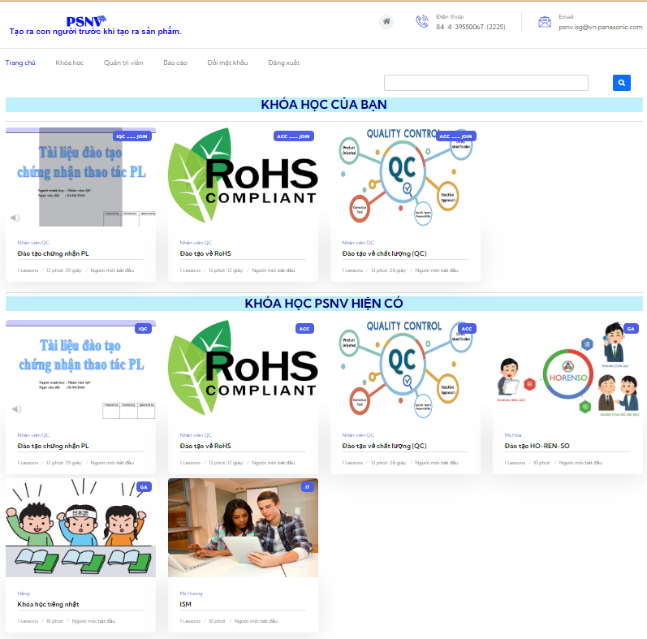
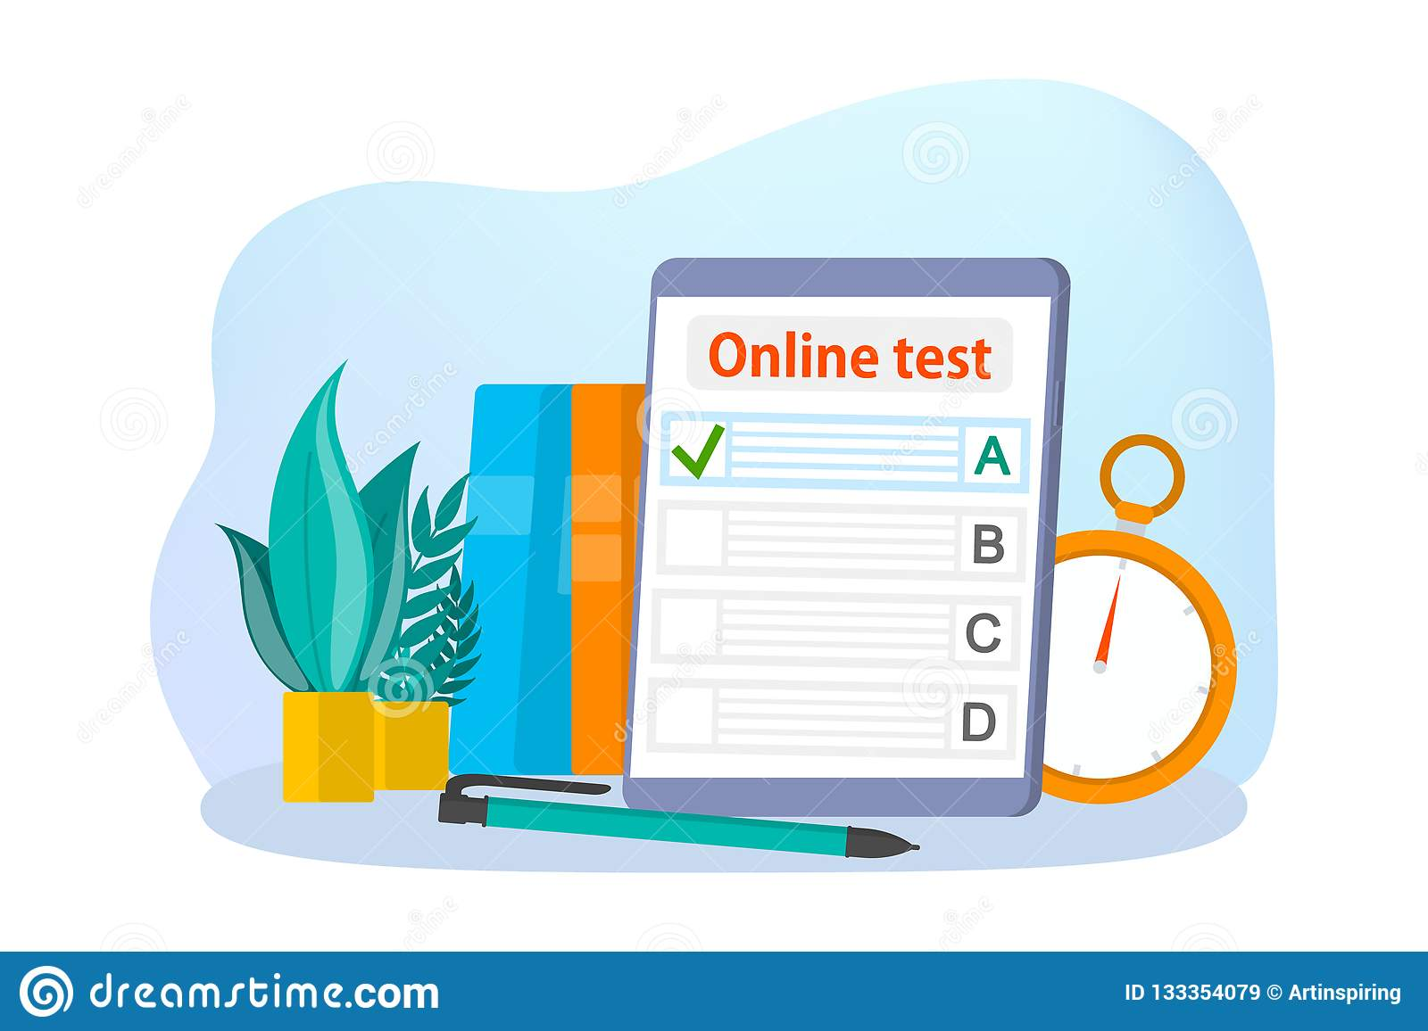

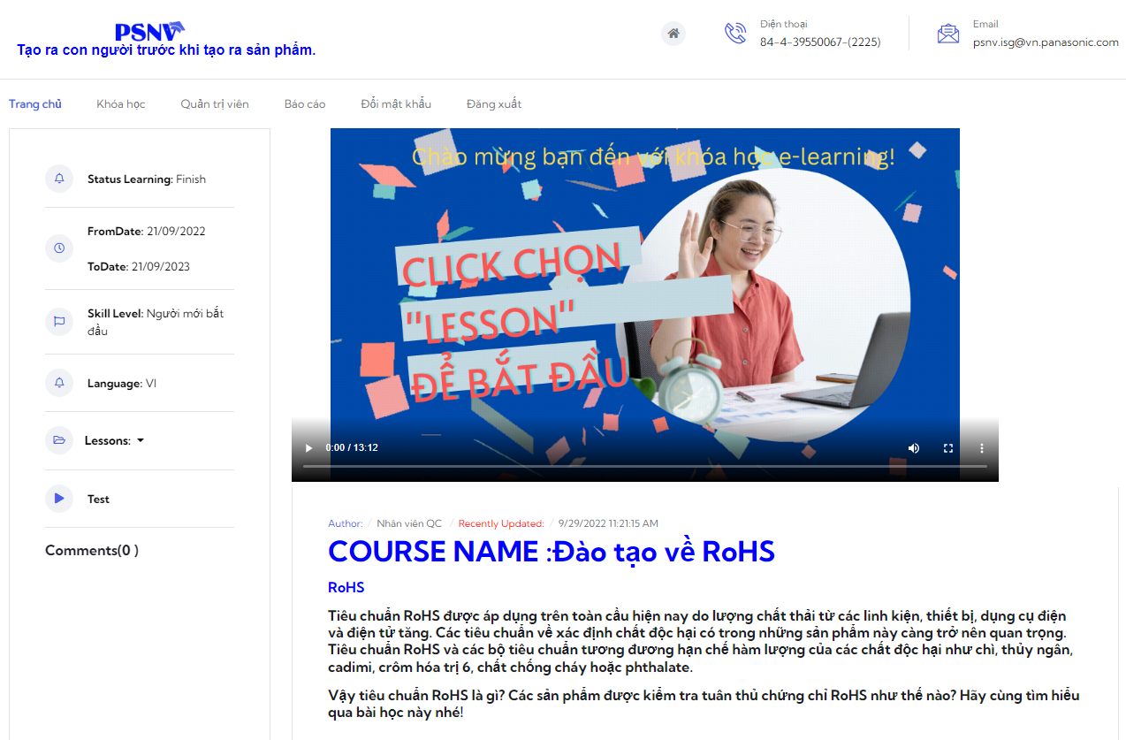


FY2022 E-LEARNING PROJECT
3/5
Online Training
Video making
Online Testing
Report
Auto Evaluation
Speech data
Merge
PPT+ Speech
Reduce 60% time for making video
Reduce 50% trainer time
Ready for expand for any training courses

Slide 5

FY2022 VISUALIZATION PROJECT
4/5
Target & Benefit:
For management:
Reduce collecting and processing PSI data
Automatize reports (Analyze with Graph/Simulation/Detect Abnormal/Reporting)
Support to make management decision quickly with high accuracy and arrange man-power to produce product swiftly and properly
For department:
Standardize master data for all category
Automatic generate and update on the fixed report
Able to create and customize report

Slide 6
FY2022 REQUEST TO DEPARTMENT
5/5
E-LEARNING SYSTEM
No | Task | Dept | Deadline
1 | Introduction and sharing to others dept | ISD/HR | 14 Oct, 22
2 | Other depts review and register courses | Related Dept | 28 Oct, 22
3 | HR expand to another training courses | HR | Q3, 22
VISUALIZATION SYSTEM
No | Task | Dept | Deadline
1 | PSI User list to access File server | PUR/PSCD | 14 Oct, 22
2 | Preparing data following system format | PUR/PSCD | 21 Oct, 22
3 | Register user list to access system | BOM/PUR/PCSD/PROD | 24 Oct, 22
Please cooperate to complete task!

